Slide 1
How Do I . . .
Common things ya gotta know!

Slide 2
Revoir’s website
www.gotbizskills.com
Look here first for information, worksheets, surveys, etc.

Slide 3
Saving computer files
Click on FILE, then click on SAVE AS.
Select the DOCUMENTS folder and give your file a NAME:
ClassPeriodYourNameProjectName
Example: B6MoaniRevoirMapping
Click on SAVE.

Slide 4
3 ways to turn in work
Turn-in-basket
Drop it to me
Share a Google doc

Slide 5

Turn-in-basket
ALL paper worksheets
When in doubt-turn it in!
Let Ms. Revoir figure it out!

Slide 6

Upload computer work.
When in doubt-upload!
Let Ms. Revoir figure it out!
revoircte

Slide 7
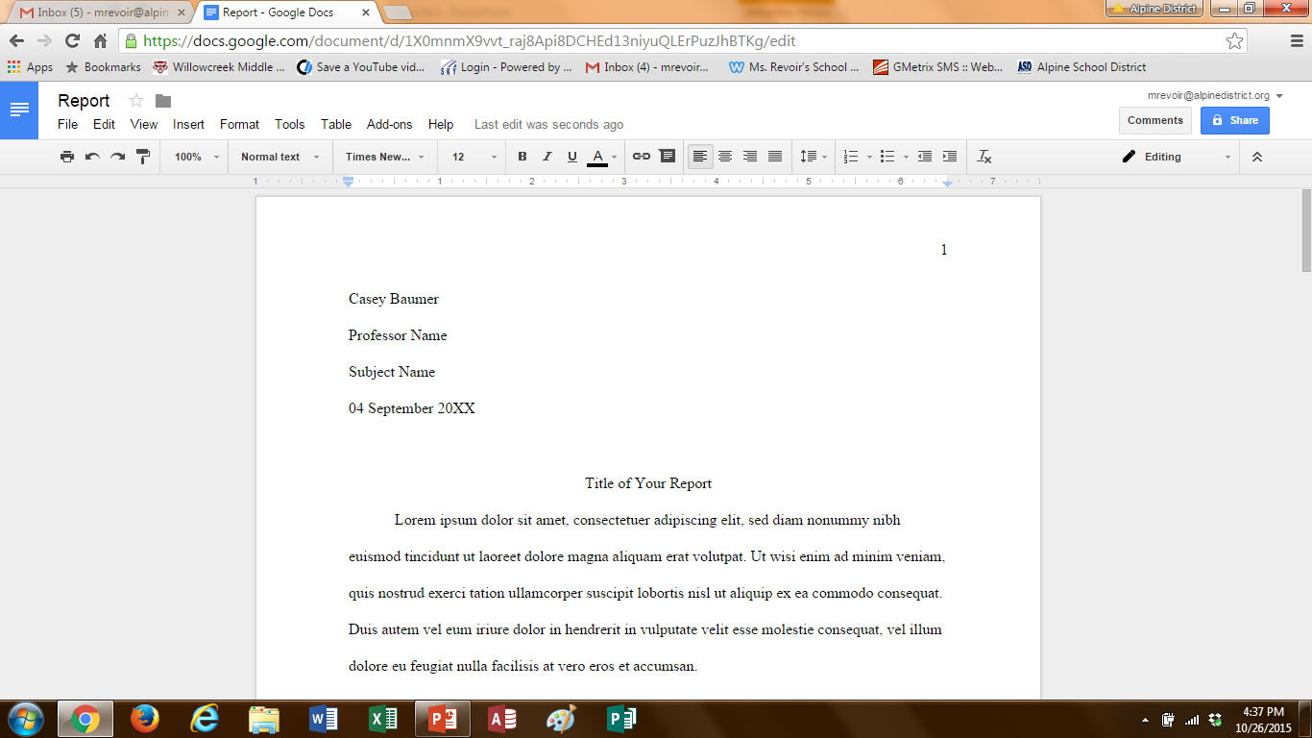
Share google docs
Click on SHARE
Type in:
mrevoir@alpinedistrict.org
Click on:
SEND

